Slide 1

FineQuo

Slide 2

Purpose
Healthy lifestyle

Slide 3
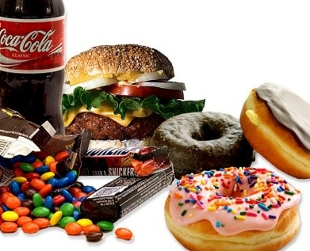
Problem
Unhealthy diet
Inconsistency towards fitness

Slide 4
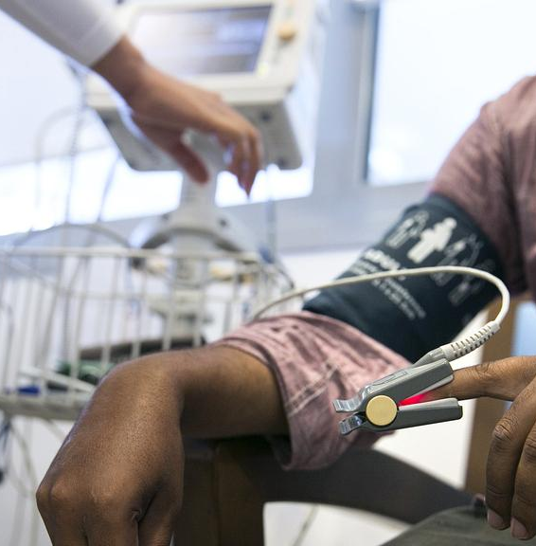
Evaluation
Appx. 41 million deaths per year due to unhealthy living
World Health Organization: “More than 85% of those occur in low- and middle-income countries.”

Slide 5
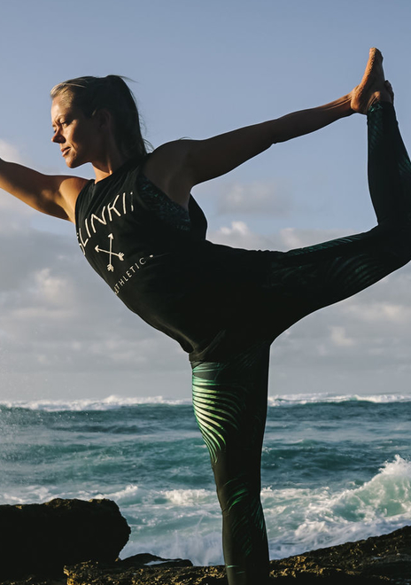
Solution
Application integrated with level based game.
Each level consists of fitness challenges.
When completed, will benefit the user and the society
Consumer rewarded at completion(Green points/vouchers)
Challenges get tougher and rewards get heavier

Slide 6
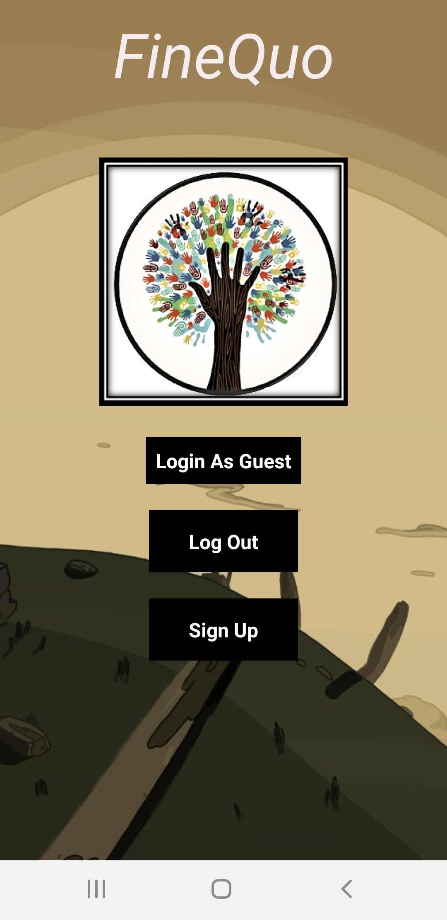
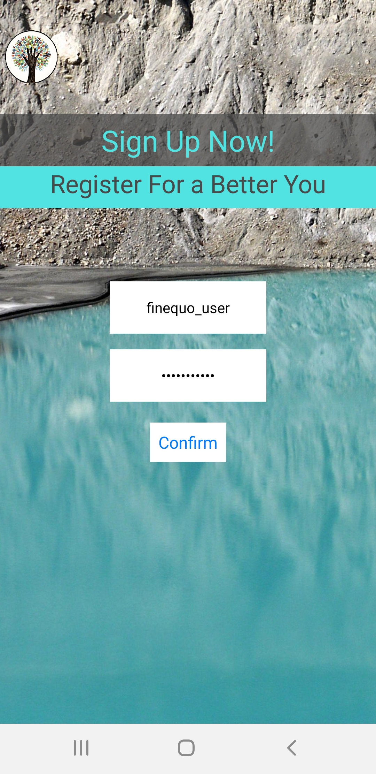
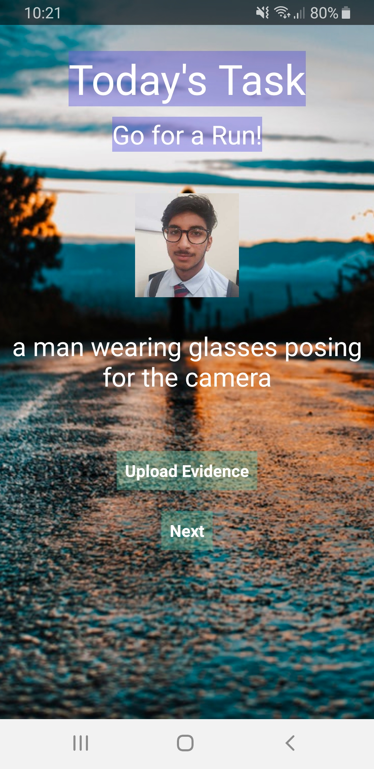
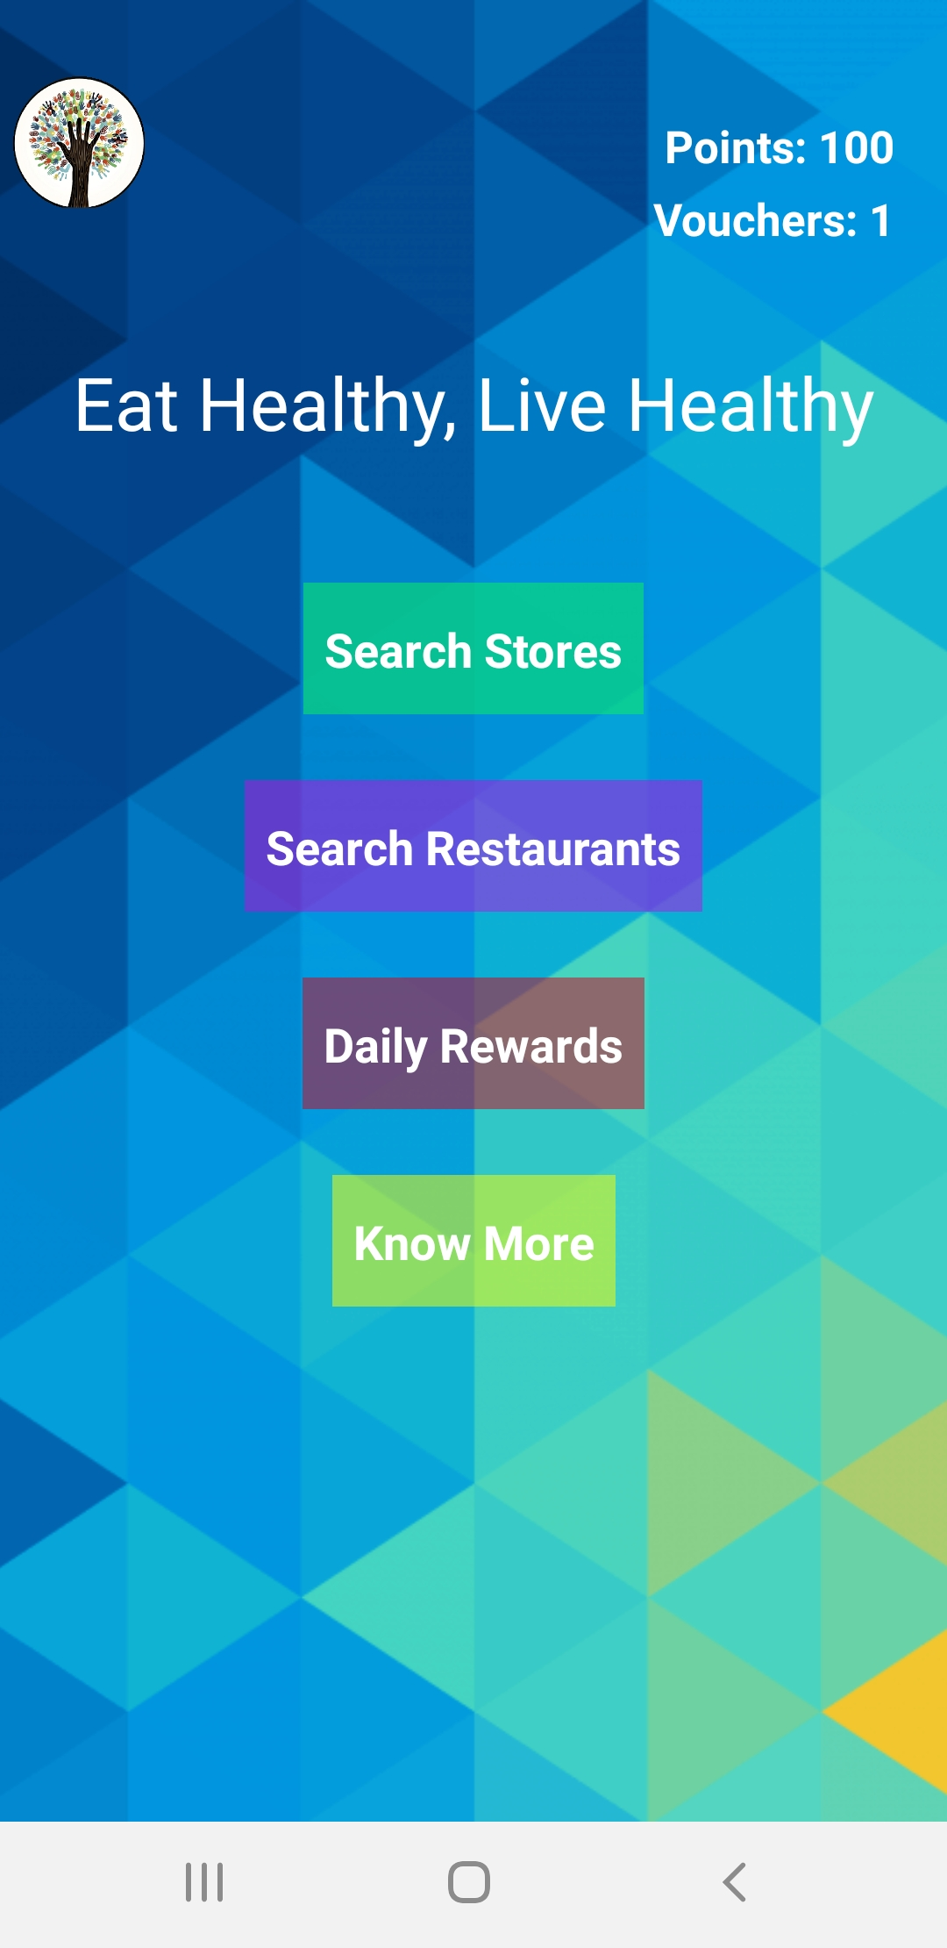

APP

Slide 7


Competition
1) Foodie
2)
Promotes healthy food to a limited extent (Chicago).
Sales of products at comparatively higher rates.
Absence of rewards system.
Consumers not willing to pay entire amounts
Delivery charges included.
Delivery Time Span -inconvenience may be caused.
Enormous orders – delivery can get mixed up.
Restricted to Internet (No App).
Paid Subscription required.
No motivation for consumers.
Only providing healthy food recipes.

Slide 8
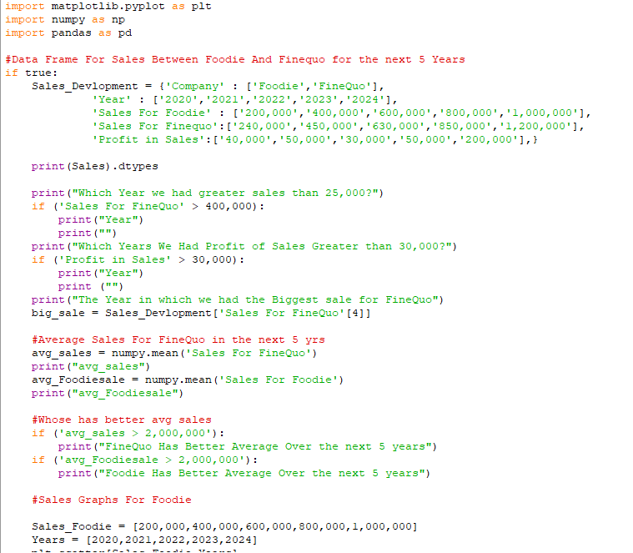
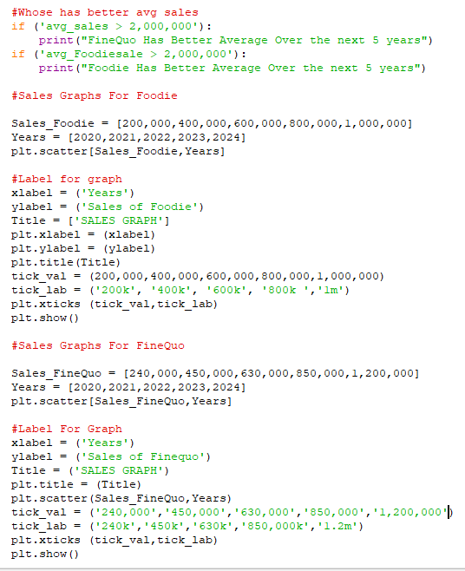
Progress
Data Science implemented program for predicted target sales, compared to “Foodie”.

Slide 9
Target Market
Revenue Growth (2019)

Slide 10

Product Awareness
Paid Promotions with-
. Fitness Centers
. Organic Food Stores and Restaurants
. Hypermarkets eg. Carrefour, Spinneys etc.
YouTube Advertisements.
Introducing a Brand Ambassador.
Newspaper Articles

Slide 11
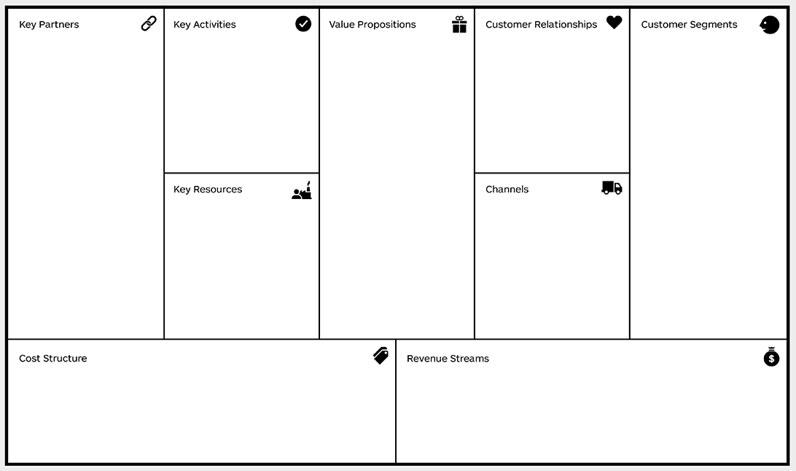
Business Model
-Organic Food Stores
-Organic Restaurants
-Hypermarkets
-Fitness Centers
-App Development
-Report Analysis
-Sales Estimation
-Reduces expenses
-Saves costs
-Extra earnings
-Green points/vouchers
-Improved health
-Time Efficiency towards fitness.
-Social Media Platforms
-Rewards system
-Loyalty Management
-Health conscious people
-Age Group 16-50
-IOS/Android users
-Overweight people
-Junk Food consumers
-App Inventing Toolkit
-AI implementation
-Website Developer
-Python For Data Science
-Website
-Social Media
-Paid Promotions
-App Licensing
-Market Research
-Revenue sharing
-Equities with organic food stores and restaurants
-Paid Promotions with charity firms

Slide 12

Strategy
App on Cross Platform(IOS, Android) to reach maximum potential consumers.
Organic Food at reduced costs.
Variety of preferred stores/restaurants on maps.
Lead Consumers to a healthy life

Slide 13

Customer Research
Online Surveys were carried out.
Questionnaires took place.
Feedback Box available on website.
Aim – To gather investment to conduct Focus Groups
Including Existing as well as potential consumers.

Slide 14

Future development
Tie-ups with organic food stores and restaurants in Dubai.
Fitness tracker on Mobile App.
Improved AI-
1) In data science for accurate sales predictions.
2) In screen recognizer for app.

Slide 15
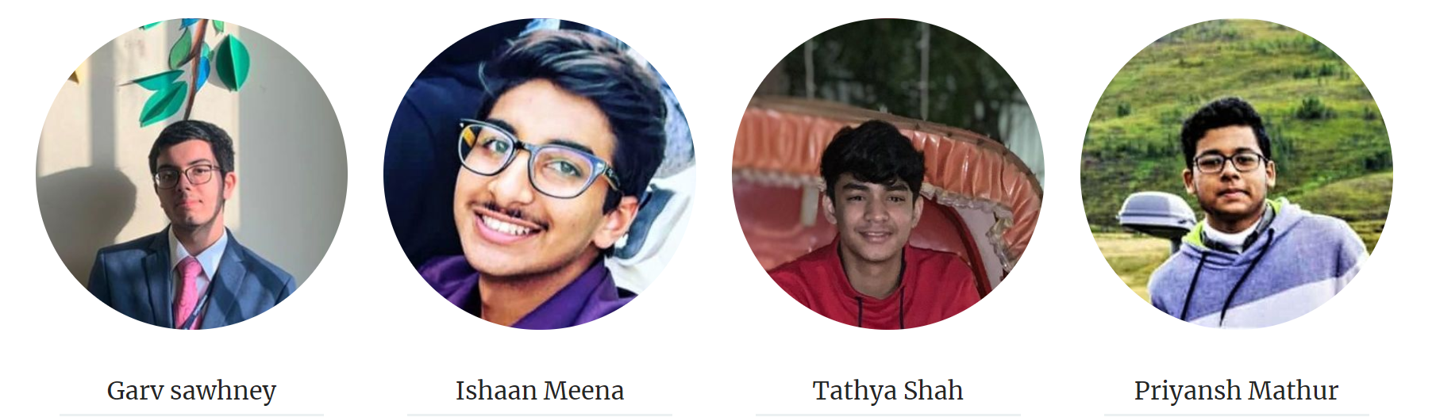
Team
The Co-Founders of Finequo -

Slide 16
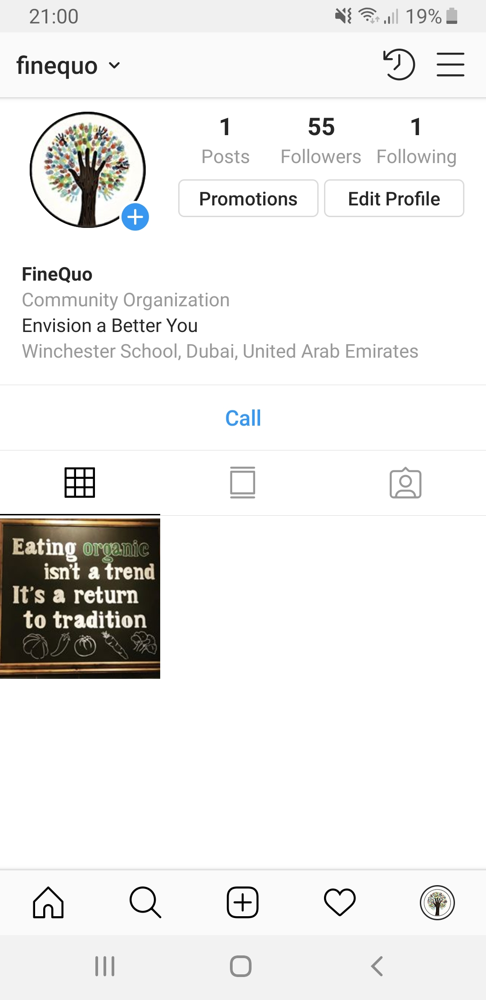
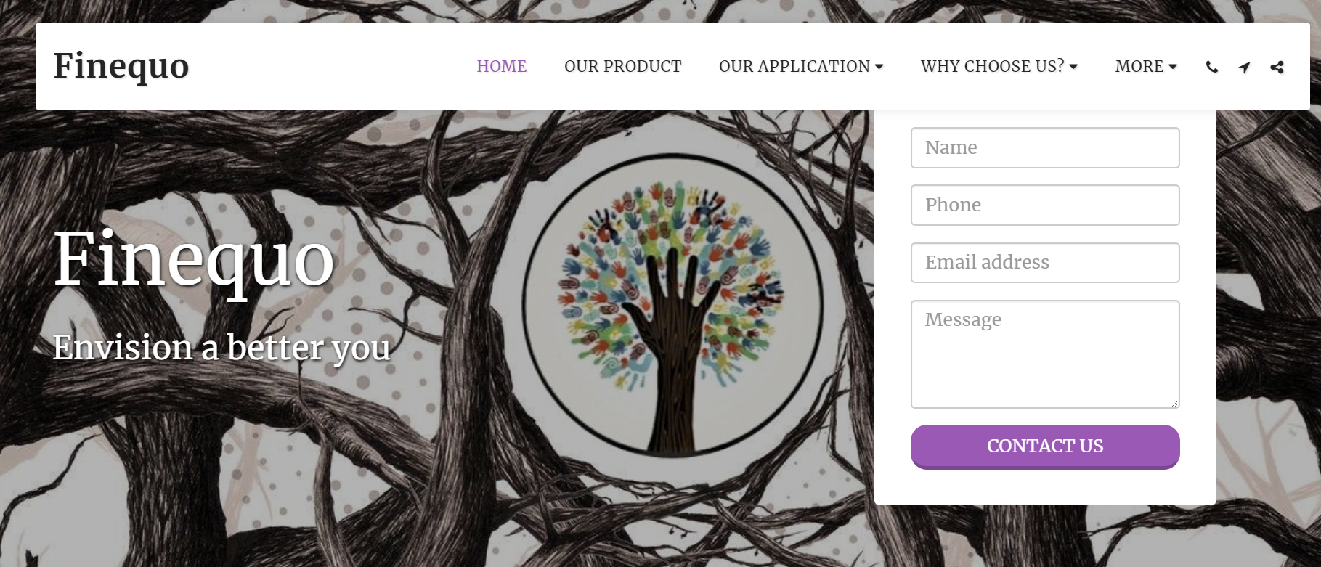
Call of Action
Contact us
Our Website - finequo.site123.me
Instagram - @finequo

